Slide 1
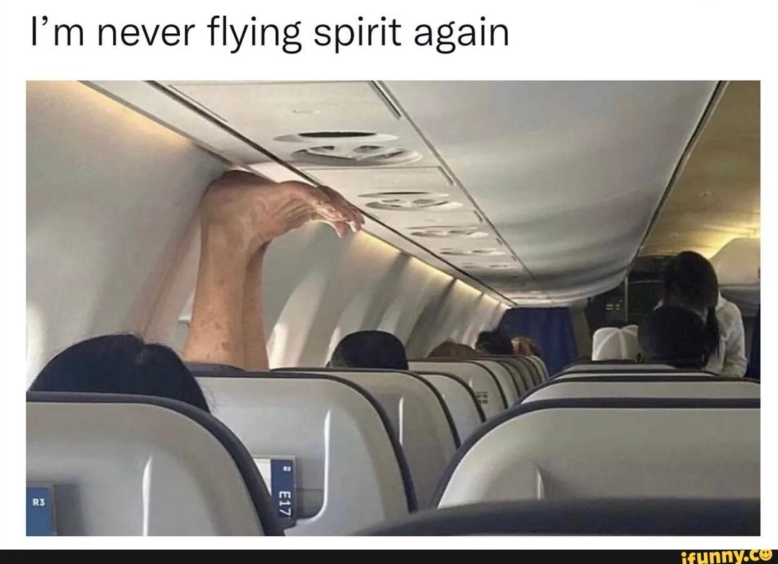
Notes:
Picture source:
https://img.ifunny.co/images/183bb8a0ecebeab3c9660fd67bd8d6a595b6bec14dabff07f1b6f3b473df9c1f_1.jpg

Slide 2


customer orientedness training
Yasemi Froissard Caballero, Dilara Nalçacı, Renée Nijssen, Antonia Vasileva, Veronika Vyvialová, Sophie Winter
Notes:
Image sources:
https://play-lh.googleusercontent.com/EAoDg62PBmZAUp5O7BYuwkmKz7IvO9f6tPs2j623xTSnDbXwPUv1ByqRtfkUtGbjwQ
https://upload.wikimedia.org/wikipedia/commons/d/db/Nieuw_logo_Hogent_2018.jpg

Slide 3
AGENDA
Problems at Spirit Airlines
About customer orientedness​
Training overview
​How to boost transfer
Evaluation of effectiveness
​Sources

Slide 4
Problems at spirit airlines
Direct problems
indirect problems
Customers:
  Dissatisfaction with the service on the plane
  Overconsumption of alcohol
  Not complying with instructions
  Physical and/or verbal violence
Crew:
  Overworking and stress
  Negative impact on performance
Mishandled or lost baggage
Delays and flight cancellations
Strikes
Reservation problems
Other anxieties of passengers
Notes:
Direct problems:
customers:
dissatisfaction with menu (food/drink) offer on the plane
overconsumption of alcohol on the plane
not complying with crew instructions
physical and/or verbal violence
crew: overworking and stress -> this might impact their performance at work
Indirect problems:
Mishandled /lost baggage
delays, flight cancellations
strikes
reservation problems
passengers that are afraid of flight/anxiety/nervousness

Slide 5
what is customer orientedness?
= Putting the needs of the customer over the needs of the business
Customer comes first and is always right
Characteristics of customer orientedness:
Aligning business goals with customer goals
Recognizing that customers are the business
When customers are satisfied, it creates customer loyalty
Notes:
What is customer orientedness ?
Customer orientation is a business philosophy that puts the needs of the customer over the needs of the business. The customer comes first and is always right. The approach of a company towards customers plays a big role with the sales of a product. This way of thinking aligns your business goals with your customer’s goal. Building a customer-oriented culture means recognizing that customers are the business. Customer-orientation is not only about customer service, but it requires support teams to master key customer service skills. This customer service creates loyalty when customers are satisfied.
Sources:
www.formatiques.com
www.researchgate.net
www.agrilife.org

Slide 6
How can you provide good customer service?
Work with empathy
Understand every customers’ requests and needs
Effective communication
Active listening
Notes:
How can you provide good customer service?
For example, in airplane’s industry with passengers and stewards of a flight. The flight attendants have to work with empathy to respond and understand every passengers’ requests and needs. In the cabin, they have to work with agility, effective communication and active listening. Every seat has to be equipped with a tv screen, so that the passenger can be entertained during its journey. They also need to be comfortable with their seat and space. So, the stewards are always checking noises, lights, or illness of the customers. For that, basic human needs have to be fulfilled. In this case, if the company exceeds the customer's expectation it’s a positive point because the customer will remember this service in a good way and also, that the customer-oriented strategy is a success.
Sources:
www.formatiques.com
www.researchgate.net
www.agrilife.org

Slide 7
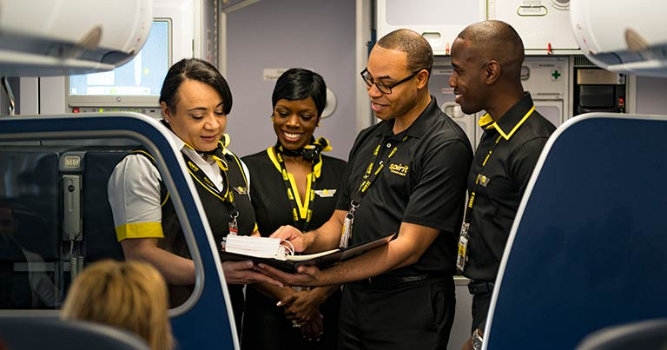
role play
Identify an issue
Describe a specific scenario
Assign roles to employees
Have participants act out the scenario
Provide feedback
Possible problems:
Lost baggage within the plane
Anger due to delayed flight
Aircraft seats mistake/printed or with another passenger/
Cleanliness complaints
Baby/child unwilling to fly
Meals ordering problems – shortage, payments, languages
Aggressive adults
Notes:
We will use Role-play because it is related to improving interpersonal skills.
The trainees will have to deal with real life situations in which a customer problematic behaviour appears.
Role-play training is an active learning strategy that requires participants to perform realistic scenarios under the supervision of a trainer or facilitator. For instance, participants might simulate the interaction between an employee and a customer. The facilitator can then provide feedback regarding the participants' performances.
Trainees are presented with real-life situations with problematic customer behaviors.
Based on a couple of prompts, the trainees act out a scenario of a customer /plane passenger/ or customers and members of the cabin crew. In that scenario they try to find a solution for solving the problematic behavior/issue that arose.
They receive feedback from the trainer, which involves psychological explanations about the reason for the customer behavior and a way to actually behave or solve the issue.

Slide 8
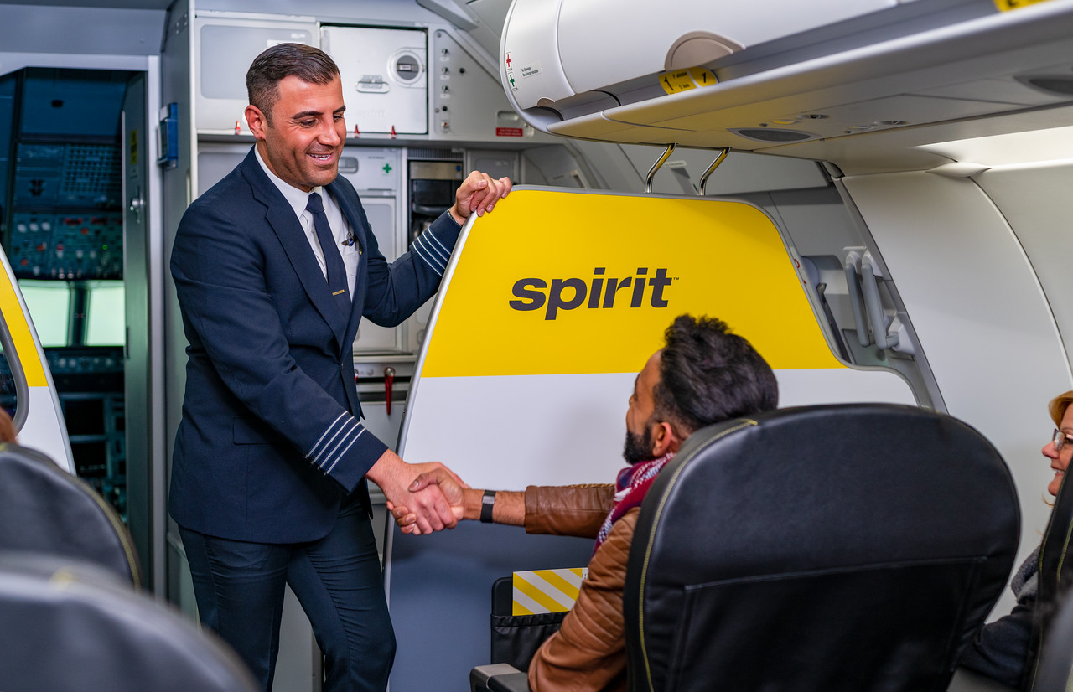
Goals
Employee can solve issues in a real job environment by taking proper, on time decisions
Analyzing the current skills of employees and highlighting their strengths & weaknesses for improvement
Employees acting in client roles -> understand the clients’ perspective & encourage overall empathy

Slide 9



Why Role play?
Interpersonal skills
PRACTICAL & HANDS ON
Cheap
Practising with colleagues and the trainer.
Closer to reality
It’s applied in a real environment and all 5 senses are used by the trainees for perception (see, hear, listen, talk, move). This makes it easier to remember and reproduce once it’s necessary again.
Being held in already available environment.
Printing costs
Trainer costs
Low costs for the company means it can be held more often. Therefore, it can be more effective.

Slide 10
how to boost transfer
before training
after training
Explain importance of training
Explain consequences of low customer orientedness (e.g., losing customers, bad brand reputation)
Clear objectives of the training
Booster session including blended learning
In-person role play and e-learning to observe reactions of team members in specific situations
Refresh knowledge, fill learning gaps
Notes:
Before training:
We will explain how serious the problem of bad customers might be (including numbers and/or real examples), and we will explain the consequences of not being able to cope with bad customer/passenger behaviour (e.g., losing customers, bad brand reputation). Thus, we make it clear how this training is important for the employees’ jobs.
After training:
We will conduct a booster session through blended learning (i.e., an in-person role play training and e-learning). Two months after the role-play has taken place, we will test via an online game how the employees will react in certain situations. That way, we can observe what was learned, and employees can refresh their knowledge.

Slide 11
evaluation of effectiveness
Evaluation of results:
Analysis of data on customer complaints before and after training
Check if number of complaints has changed
Evaluation of behaviour:
Supervisors observe employee behaviour
Appreciation from supervisors, track learning progress of employees
Notes:
Evaluation of results:
Data on customer complaints (before and after the training) should be analyzed, to check if there are less complaints after the training.
Evaluation of behaviour:
To evaluate the behaviour of the employees, supervisors or managers can see how the employees do their job and observe if there has been a change in behavior. This will help track the learning progress of employees, and it will also create appreciation from the supervisor towards the employee.

Slide 12
evaluation of effectiveness
Evaluation of learning:
Role play/on-the-job: put employees in a challenging situation
and observe employee reactions
Judge training effectiveness based on behaviour of employees
Evaluation of reaction:
Questionnaire related to topics of the training
Test knowledge and reactions of employees
Notes:
Evaluation of learning:
We will put the employees in a difficult and challenging situation that could potentially happen on their job. This could be done via a role-play, or in real time on the job (e.g., with other employees disguised as customers). Then, we can judge the effectiveness of training by the way the employees handle the situation.
Evaluation of reaction:
We will give the employees a questionnaire with several questions regarding what was learned in the training. That way, we can test whether they know how to respond (theoretically) to the issue at hand.
Extra information
Questionnaire (this is part of the evaluation of reaction):
Was the training useful for you?
Did you learn something new?
Were the topics/problems discussed enough?
Were the problems discussed vital/have happened often in your flights?
Would you suggest more/different topics?
How well were the problematic situation acted: assess via clicking on a 🙂😐☹️
How well were the solutions presented: 🙂😐☹️.
How well were the instructors and actors performing: 1-5 scale.
Reflection
As a reflection, we could also make the employee realise that what they have learned is essential to their job and that they have grown. (giving compliments + feedback)

Slide 13
THANK YOU!

